Slide 1
Home Application
CAPSTONE PROJECT

Slide 2
INTRODUCE
Home Application:
Is All in One application.
Help user find necessary information fast and easily.
Widget quick access
List installed Applications
Name: Ho Khanh Vu
Roll Number: SE05427

Slide 3
Requirement

Slide 4
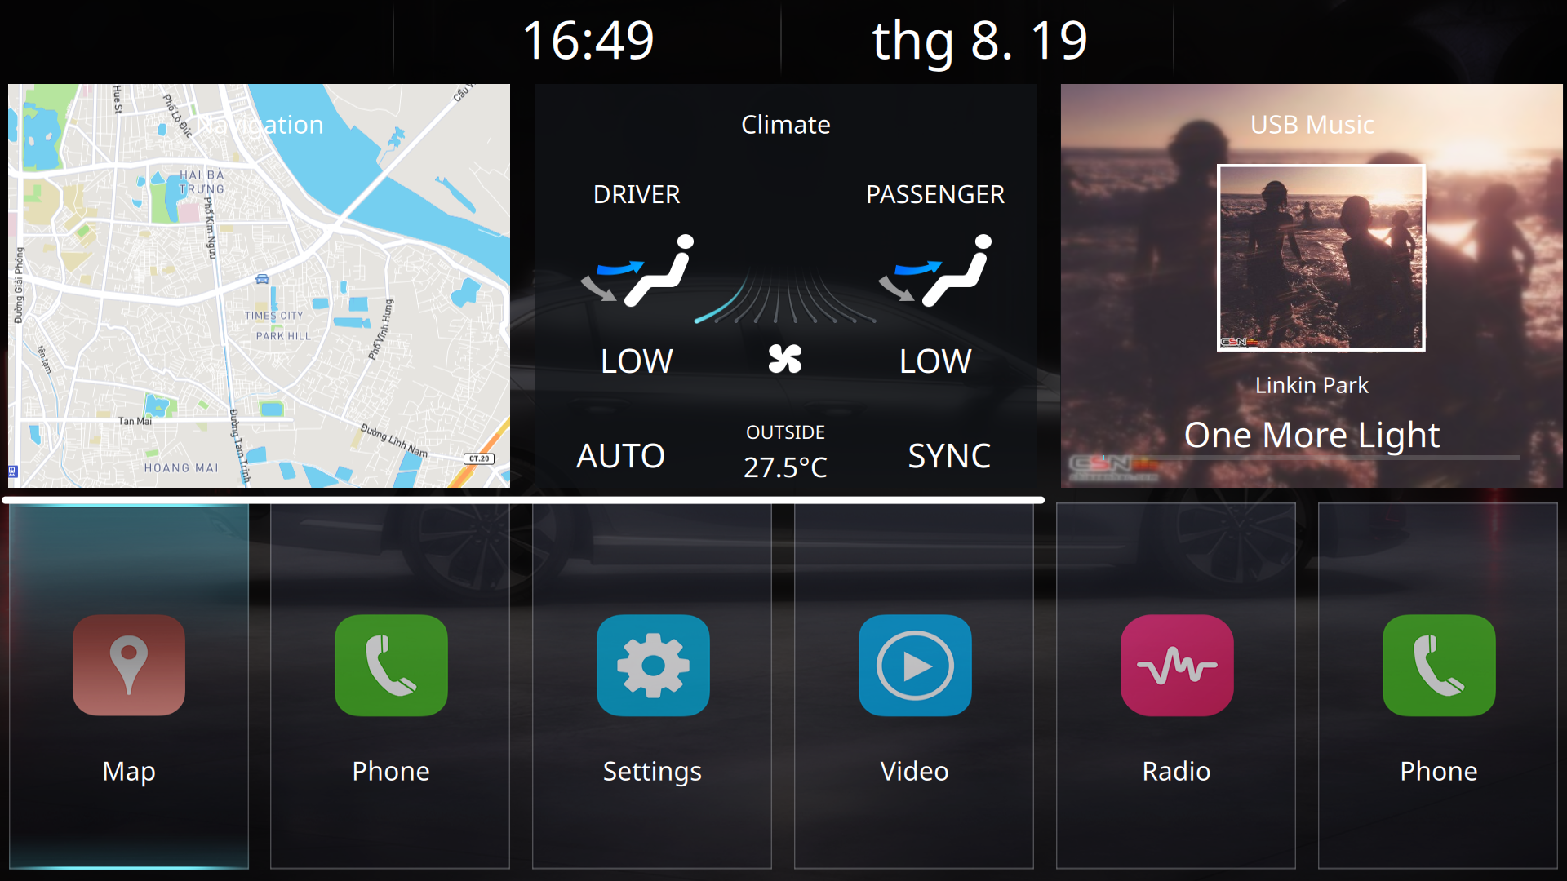
R: Home Screen
- Able to display Home Screen
- Divide into 3 section
* Status Bar
* Widgets
* Application

Slide 5
R: Status Bar
- Display current time with format HH:mm 24h
- Display current date with format MMM. dd

Slide 6
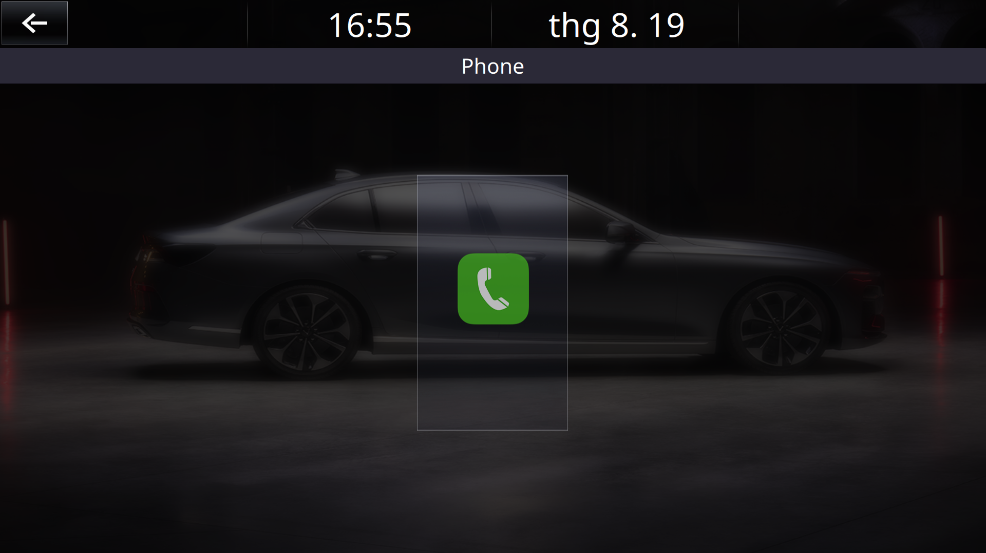
R: Status Bar
- If inside an application or widget screen, show back button

Slide 7
R: Widgets
- Have 3 widgets
* Navigation ( Map )
* Climate
* USB Music
- Able to open corresponding application when click on a widget.

Slide 8
R: Applications
- Display list of application stored in XML file
- Able to rearrange list application
- Able to open corresponding application when click on application icon

Slide 9
System design

Slide 10
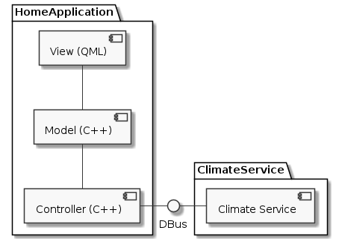
SD: Architecture Design
- 3 Layer
+ View (QML): Control display screen
+ Model (C++): State management
+ Controller (C++): Core, connect to 3rd service
- Connect to Climate Service using DBus

Slide 11
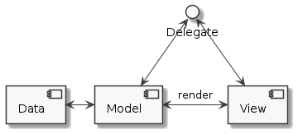
SD: Model view architecture
- Data: XML Store applications information
- Model: Class store applications list parse from XML file
- View: QML display application list

Slide 12
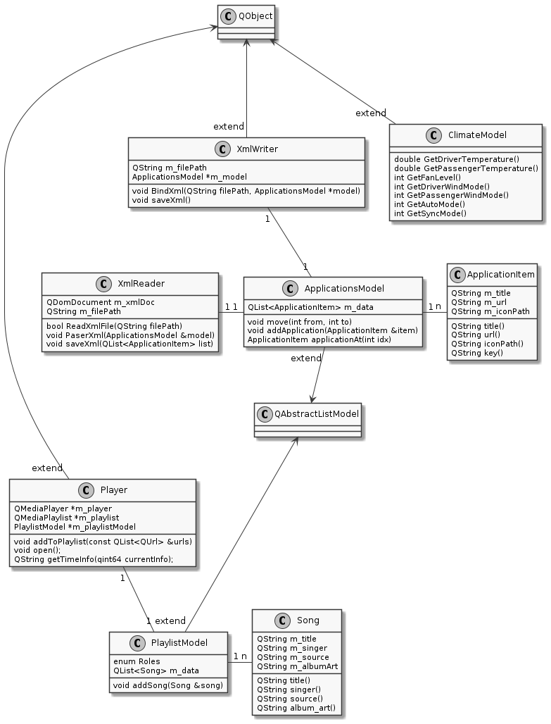
SD: Class Diagram

Slide 13
UI - UX

Slide 14
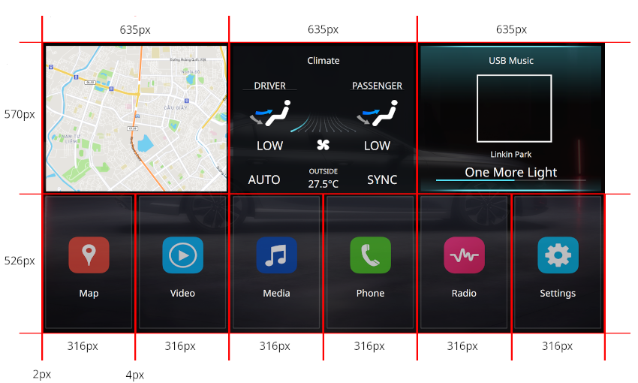
UI - UX: Homescreen
- Home Screen size

Slide 15
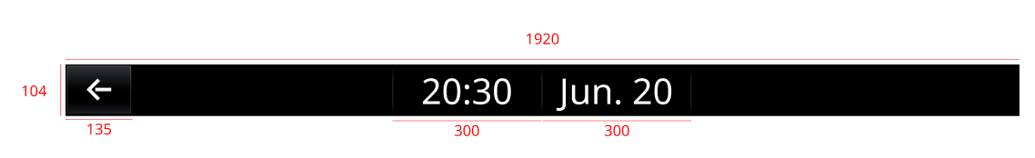
UI - UX: Status Bar
Back Button ( only show when not in Home Screen ), use for return to Home Screen
Current time
Current date

Slide 16
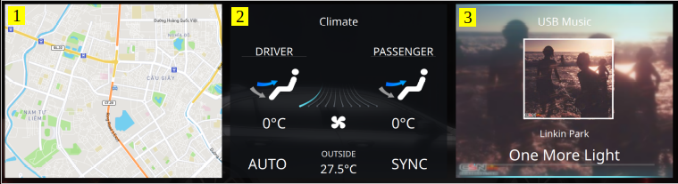
UI - UX: Widget
570px
635px
Navigation Widget
Climate Widget
Media player Widget

Slide 17
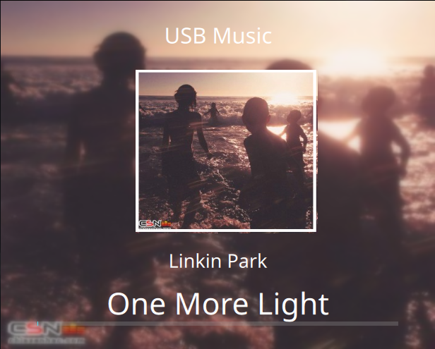
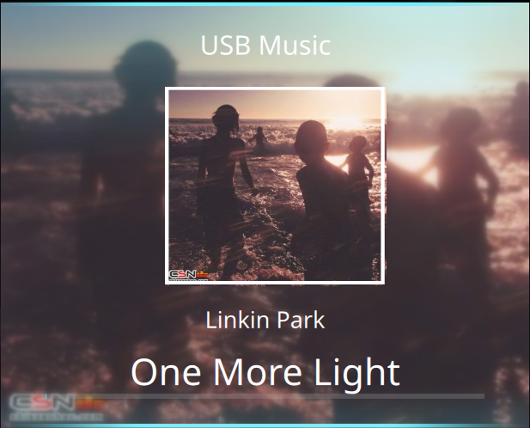
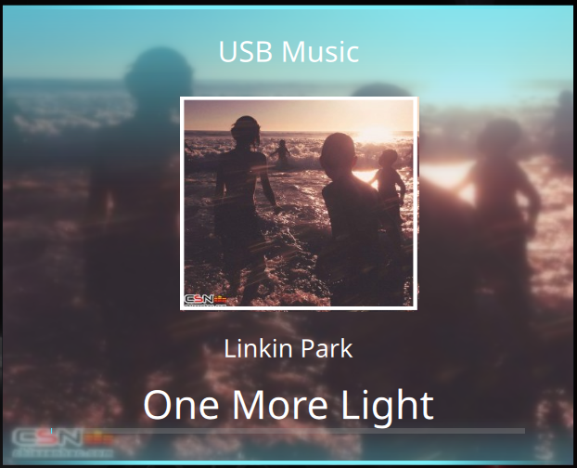
UI - UX: Widget Button
Normal
Focus
Pressed

Slide 18
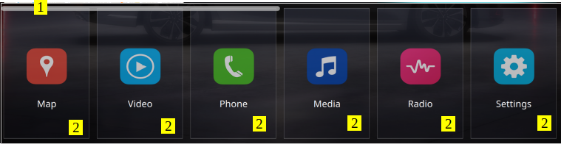
UI - UX: Applications list
526 px
316 px
Scroll bar ( when there are more than 6 application )
Application Icon

Slide 19
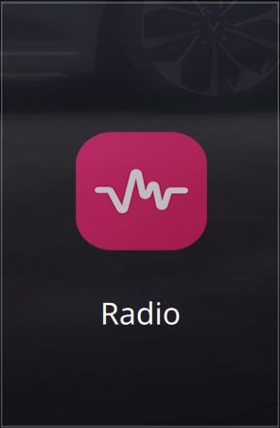
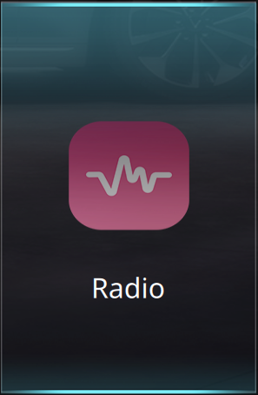
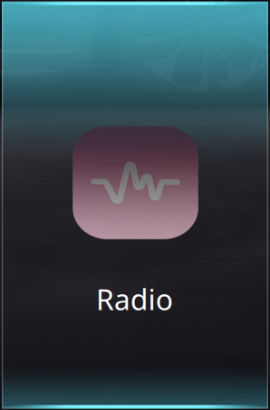
UI - UX: Application Button
Normal
Focus
Pressed

Slide 20
Flow specification

Slide 21
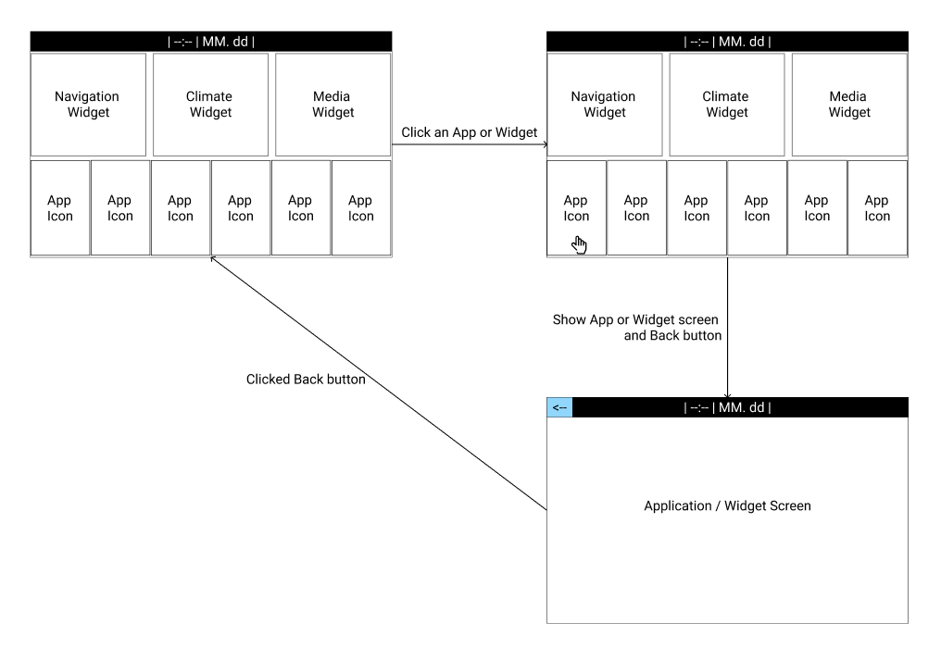
F: Open - Close application

Slide 22
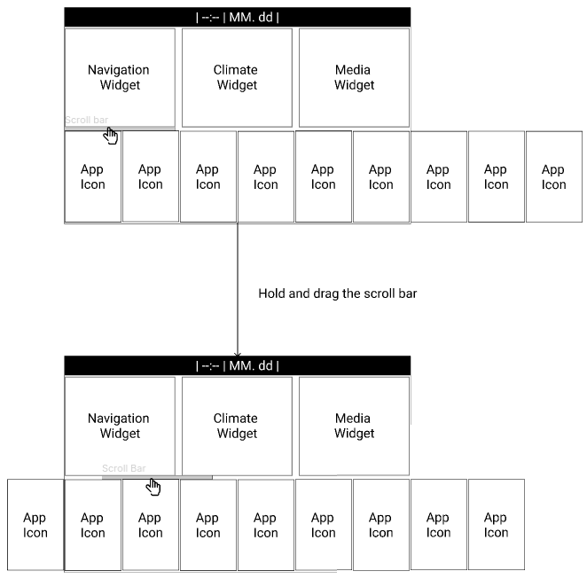
F: Scroll application list

Slide 23
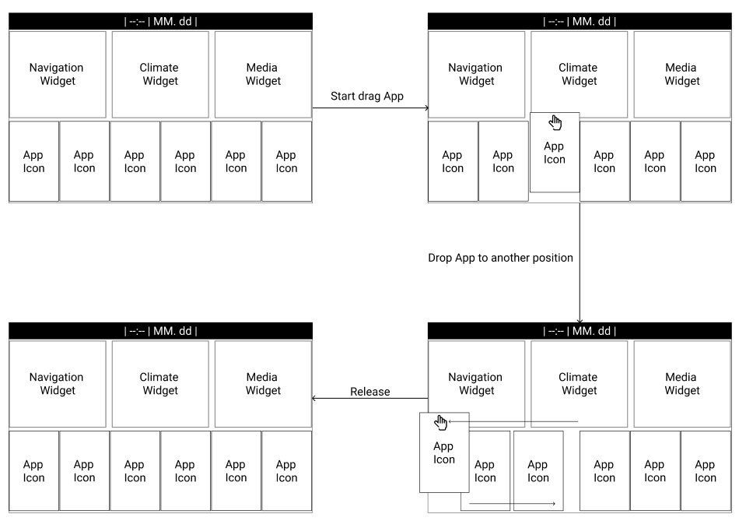
F: Rearrange Application list

Slide 24
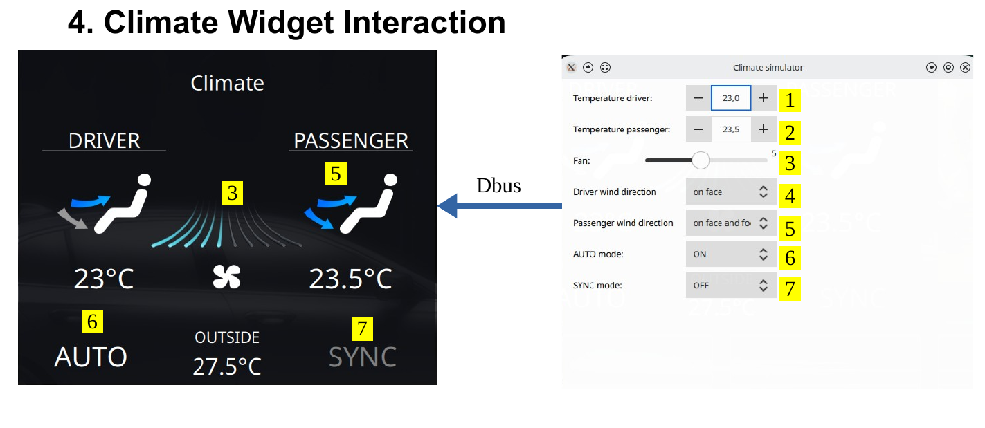
F: Climate Service interaction

Slide 25
Testing

Slide 26
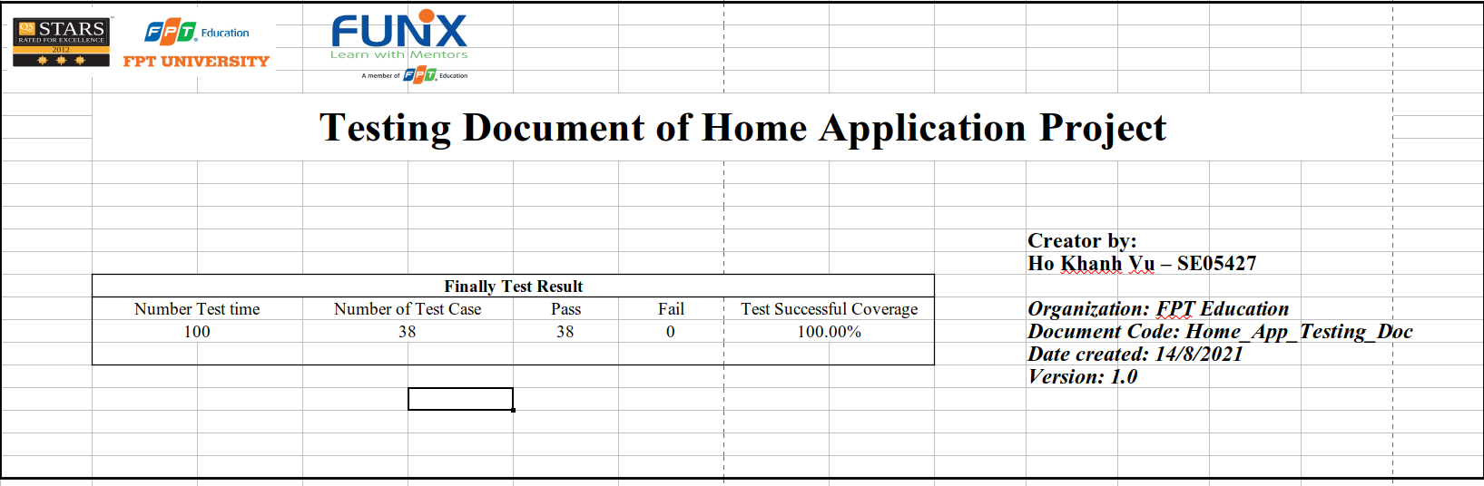
T: Testing result
Number of test case: 38
Passed: 38
Coverage: 100%

Slide 27
Demo

